Slide 1
Automatic Solar Tracking System
Presentation by
OMKAR GUJJA ( 71 )
SHASHIKANT SADHAPHULE ()
ADVAIT BHOSLE ()
Under the Guidance of
Prof. Raghuvendra S. Upadhyay
Department of Mechatronics Engineering
TERNA ENGINEERING COLLEGE NERUL
University of Mumbai

Slide 2
Introduction
What is Solar Energy?
Solar energy is radiant light and heat from the Sun that is harnessed using a range of ever-evolving technologies such as solar heating, photovoltaics cells.
World Energy Conservation predicted estimation about the rate of utilization of energy resources shows that the coal deposits will deplete within the next 200 to 300 years and petroleum deposits , deplete in next few decades.

Slide 3
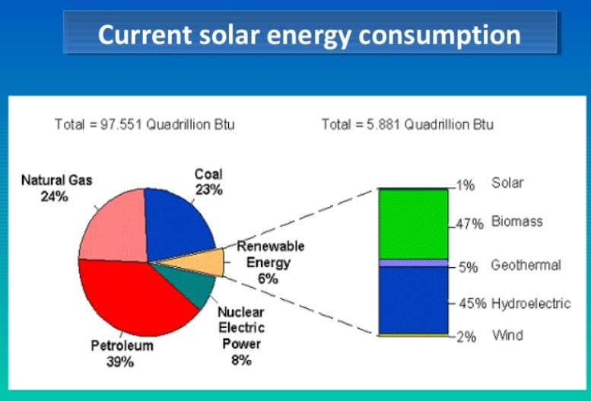
Introduction

Slide 4
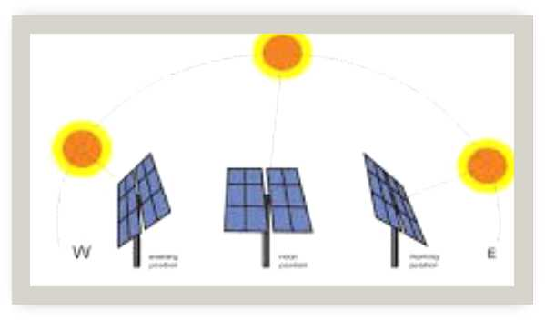
Problem Definition
Need For A Sun Tracking System
From dawn to dusk the sun keeps changing the angle from 0-90 rising and 90-180 declining.

Slide 5
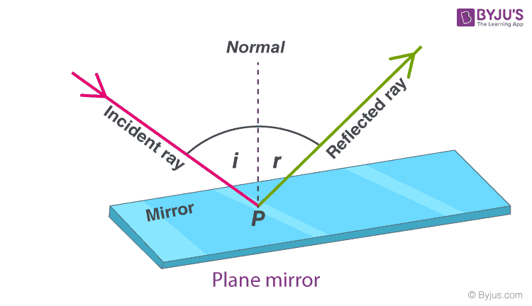
Objective & Scope of Project
The aim of the project is to keep the solar photovoltaic panel perpendicular to the sun throughout the year in order to make it more efficient.
Conditions For Maximum Output.
The difference between the incident ray and the reflected ray should be equal. to zero, i.e. the rays should be perpendicular to the panel.

Slide 6
Project Implementation/Methodology

Slide 7
Future Scope

Slide 8
(Gantt chart)Schedule of project work

Slide 9
References

